Slide 1


Predictive Modeling for Attorney Involvement in Claims
Team – 3

Slide 2
Team Members:
Mohan Kumar N.C
Nushrath Shaik
Mada Srinidhi
Abhinav Gundala
Riteesh.D.Ambekar
Piryanka Shridhar Katkar
Bonala Rahul

Slide 3
Objective
Develop a predictive model to estimate attorney involvement in claims based on claim characteristics.
Identify the key variables influencing attorney involvement, such as claim amount, injury severity, location, and claimant demographics.
Enhance predictive accuracy to support claims management and decision-making.
Reduce dependence on manual evaluations and improve efficiency in determining potential attorney involvement.
Provide a data-driven approach to aid in strategizing claims resolution and minimizing legal costs.

Slide 4
Introduction
Attorney involvement in claims is influenced by various claim-related factors, making accurate predictions essential for effective claims management.
This project aims to leverage machine learning techniques to predict attorney involvement using a dataset of claim characteristics.
The dataset includes variables such as claim amount, injury severity, location, claimant demographics, and attorney involvement as the target variable.
Predicting attorney involvement based on claim factors can help optimize resolution strategies and reduce legal expenses.
By understanding the relationships among these variables, we can improve efficiency and effectiveness in claims processing and management.

Slide 5
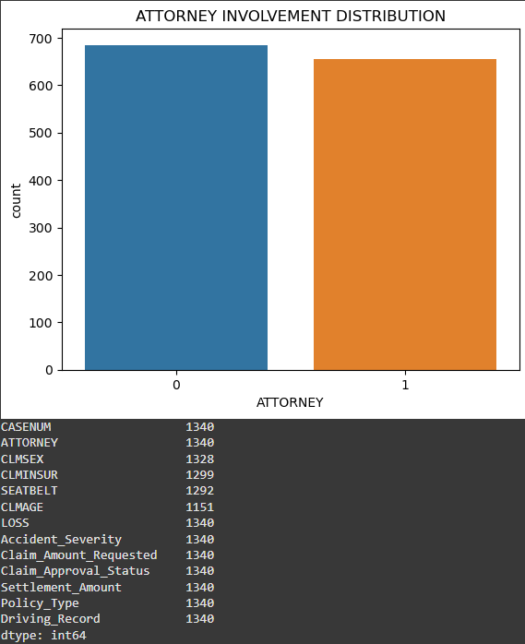
Graphs
Sns Countplot:

Slide 6
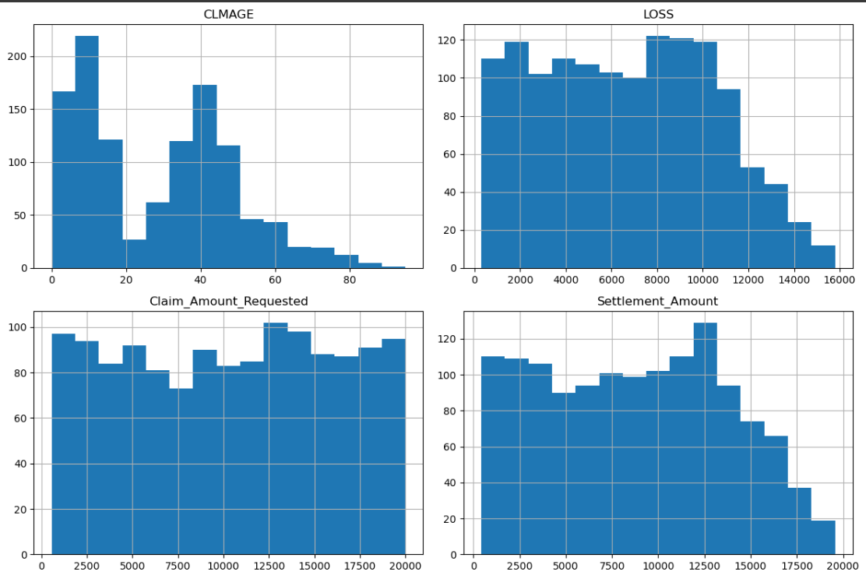
Graphs
Histograms:

Slide 7
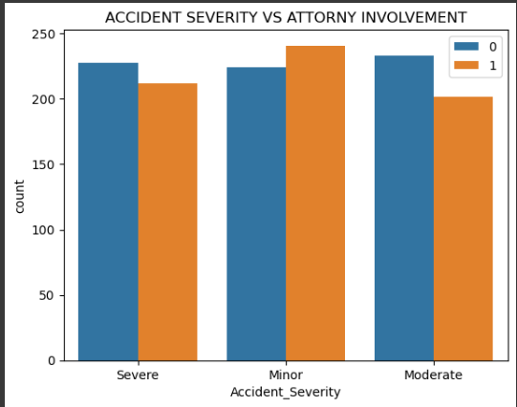
Graphs
SNS Pair plot:

Slide 8
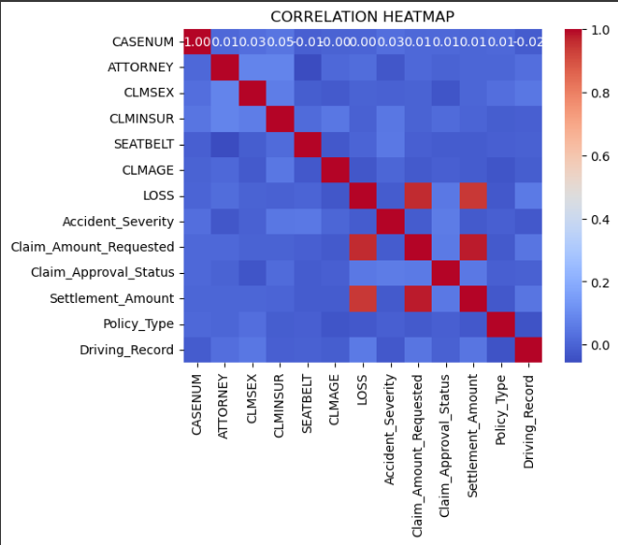
Graphs
Heat Map:

Slide 9
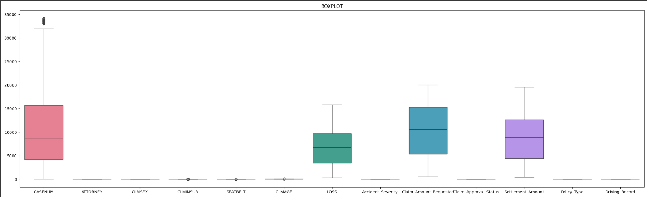
Graphs
Boxplot :

Slide 10
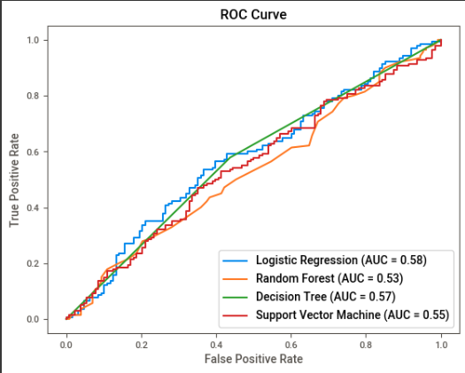
ROC CURVE

Slide 11
List Of Models Taken for Deployment
Logistic Regression
Random Forest
Decision Tree
Support Vector machine

Slide 12
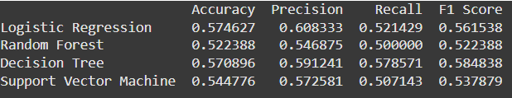
Comparison Between each model

Slide 13
Summary Based On the Comparison Table
Logistic Regression has the highest precision (0.608333), recall (0.521429), and F1 score (0.561538), making it the most balanced and best-performing model overall.
Decision Tree shows competitive performance with a slightly lower F1 score (0.584838) but does not outperform Logistic Regression.
Random Forest has the lowest performance across all metrics, making it the least effective model.
Support Vector Machine shows moderate precision (0.572581) but falls behind in recall and F1 score compared to Logistic Regression.
Logistic Regression stands out as the optimal choice for this task due to its superior balance of precision, recall, and F1 score.

Slide 14
Conclusion
In conclusion, Logistic Regression is the most suitable model for this task, offering the best balance between precision, recall, and F1 score. It ensures reliable predictions and outperforms other models in terms of overall performance.

Slide 15
Code Description
EDA:
Imported dataset and examined structure, identified and removed missing values and duplicates. Visualized distributions (pair plots, box plots) and relationships (correlation heatmap).Applied IQR method to detect and remove outliers.
Data Partitioning:
Split features (X) and target ('energy_production'), partitioned data (80% train, 20% test).Scaled features using StandardScaler.

Slide 16
Code Description
Model Training and evaluation:
Models Tested: Linear Regression, SVR, Random Forest, Lasso, Ridge, Decision Tree, XGBoost, LightGBM, Gradient Boosting, ElasticNet, KNN, CatBoost.
Metrics: Evaluated models using Mean Squared Error (MSE), Mean Absolute Error (MAE), and R-squared (R²).
Results: Compiled metrics into a DataFrame for performance comparison, identifying best and worst models.

Slide 17
Attorney Involvement Prediction Model Deployment
Objective: Deploy a user-friendly app for predicting attorney involvement in claims based on claim characteristics.
Platform: Streamlit, chosen for its simplicity in building interactive and efficient web applications with minimal coding effort.
Deployment Model: The app integrates a pre-trained Logistic Regression model (logistic_model.pkl) to generate real-time predictions of attorney involvement. Users input parameters such as claim amount, injury severity, location, and claimant demographics, with pre-defined ranges to ensure valid entries. Upon clicking the prediction button, the model processes the inputs and returns a result indicating the likelihood of attorney involvement, formatted as a percentage.

Slide 18
Attorney Involvement Prediction Model Deployment
User Experience: Streamlit’s intuitive design allows for a responsive interface where users can seamlessly enter data and obtain predictions. The app includes robust error-handling mechanisms to ensure smooth operation. A sidebar provides a brief description of the app's purpose and usage, enhancing the overall user experience with clarity and functionality.

Slide 19
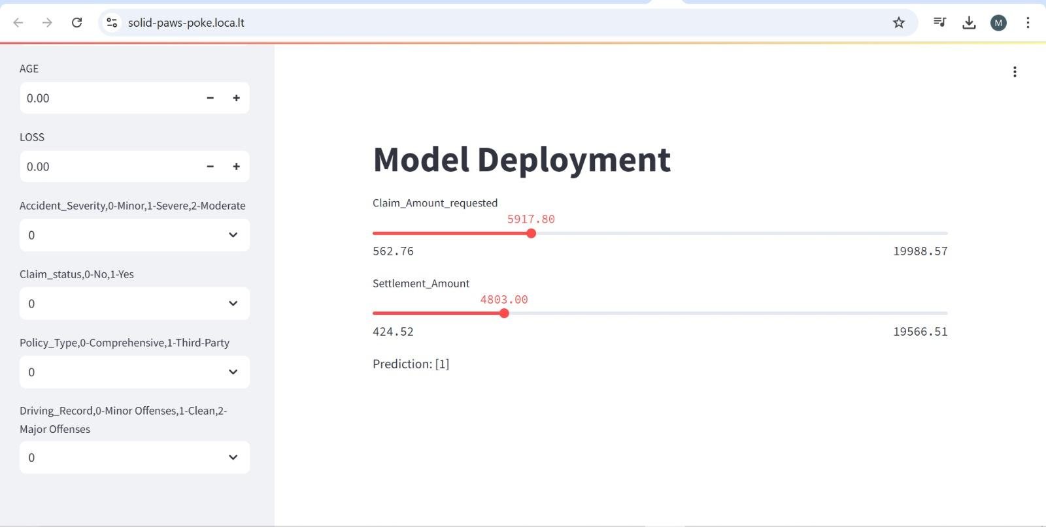
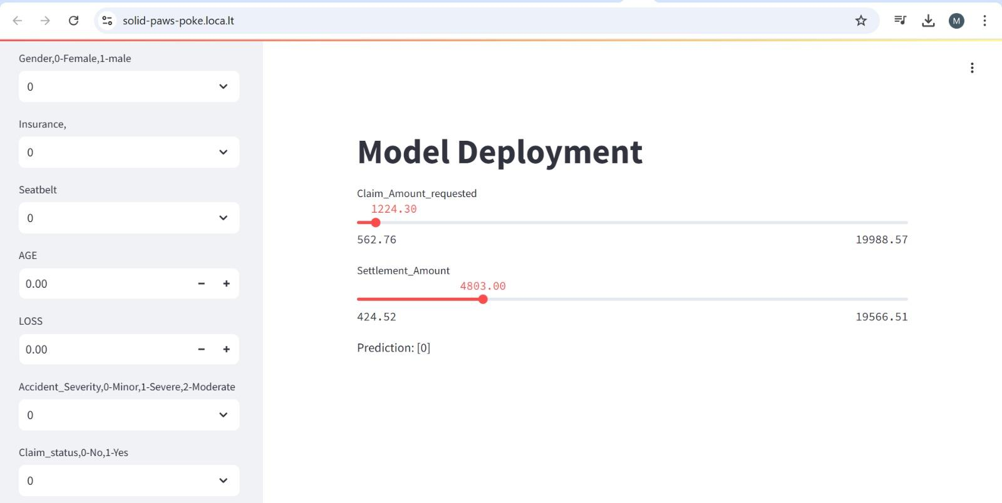
Post – Deployment:

